Slide 1
Padlet and weebly
For Presentation and Publication

Slide 2
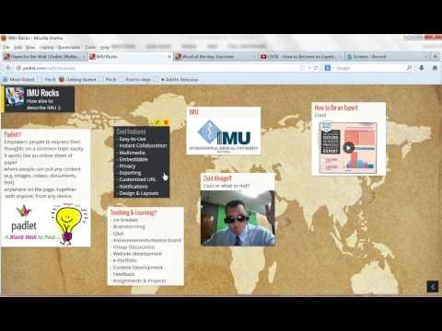
A Quick Tutorial…

Slide 3
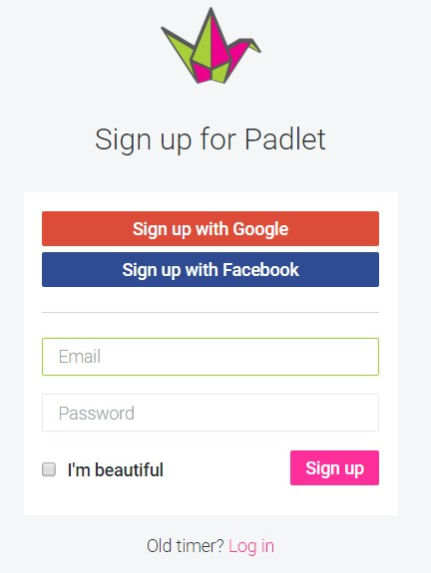
Get an account.
Sign up or use your Google Account.

Slide 4
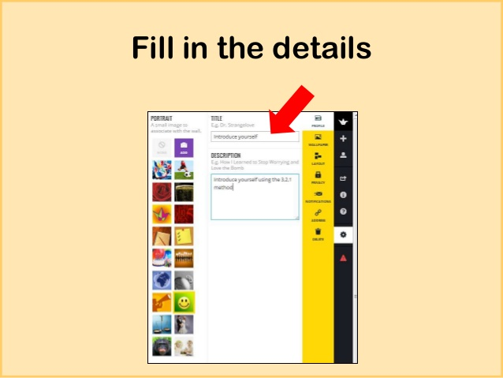
Use the description box to ask questions, describe expectations, or give instructions.

Slide 5
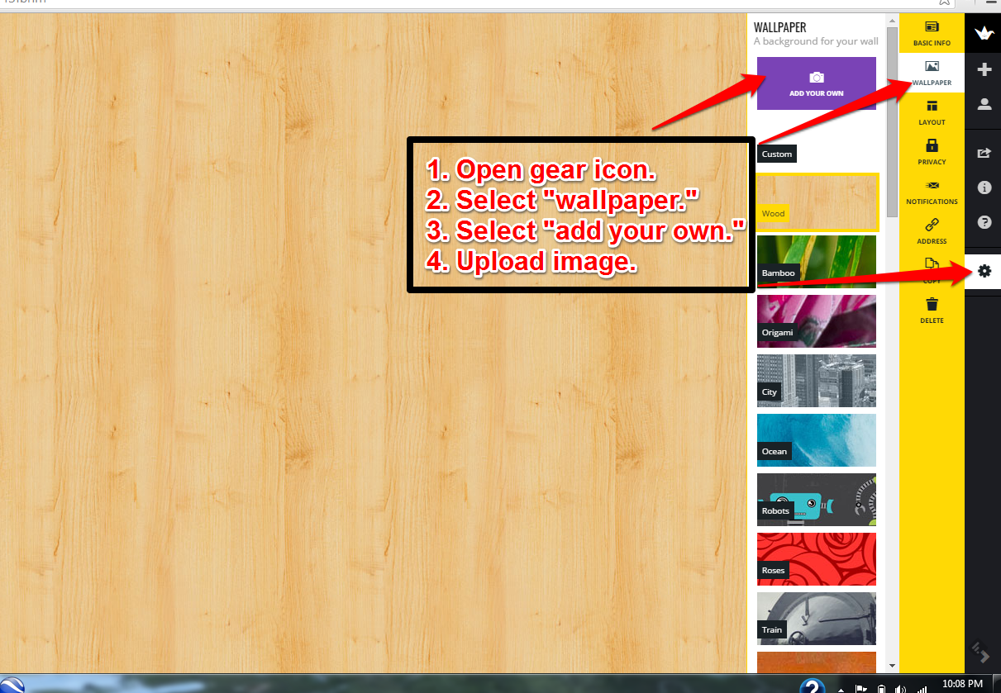
Pick a Wallpaper
You can add your own if necessary.

Slide 6
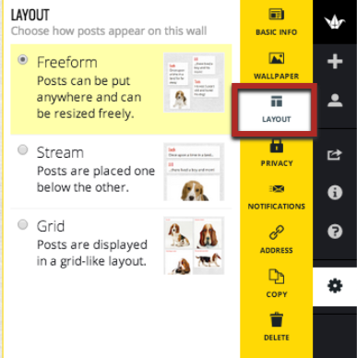
Pick a Layout.
Freeform – posts appear -on page. Great for brainstorming.
Stream - posts under one another. Great for blog style discussions.
Grid – Displayed in grid fashion. Great for displaying projects.

Slide 7
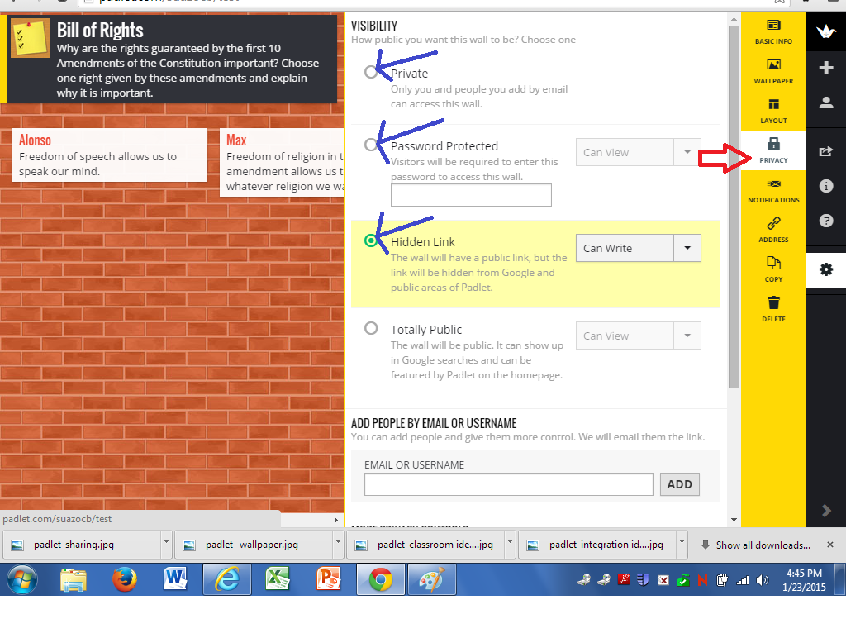
PRIVACY
Private – You must provide emails of people who may view wall.
Password Protected – Visitors must have a password to visit wall.
Hidden Link – The wall will have a link but will not be shared in public areas.

Slide 8
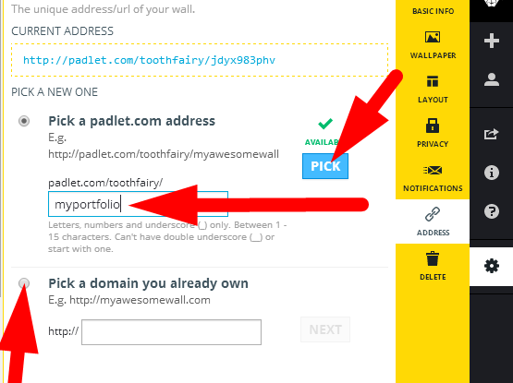
PICK AN ADDRESS
Padlet will automatically provide you with a link.
You may easily change the link to your liking.

Slide 9
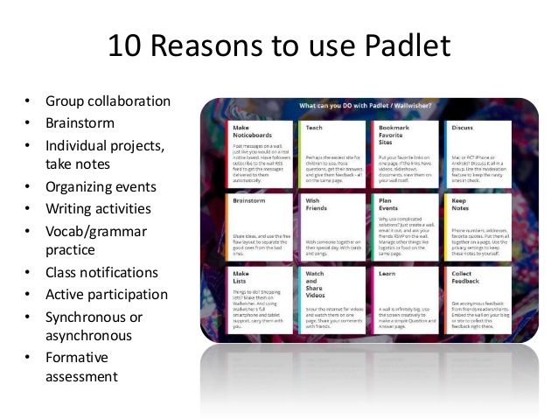

Slide 10
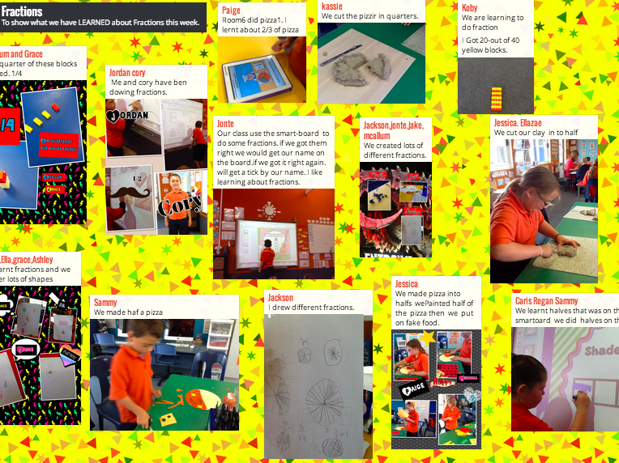
Sharing what we learned.
Post a picture with text showing what we learned.

Slide 11
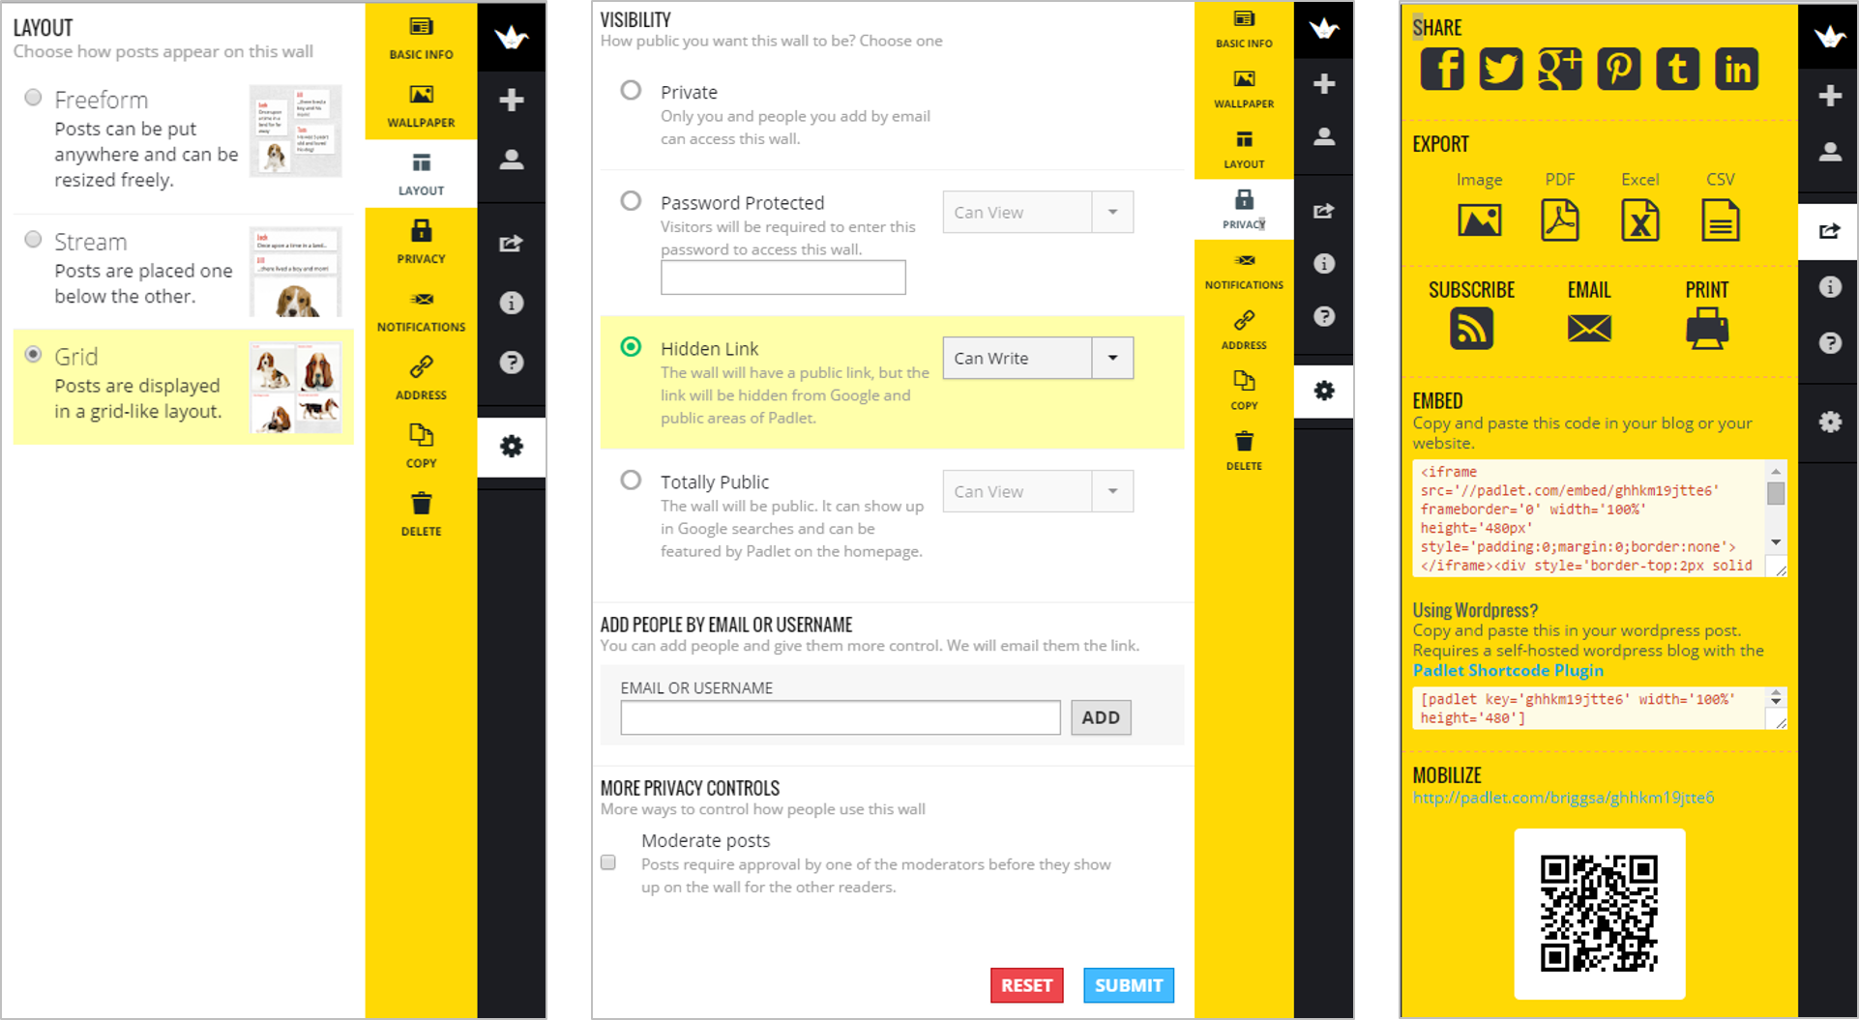
SHARING
Embed code provided
Link provided
QR Code provided

Slide 12
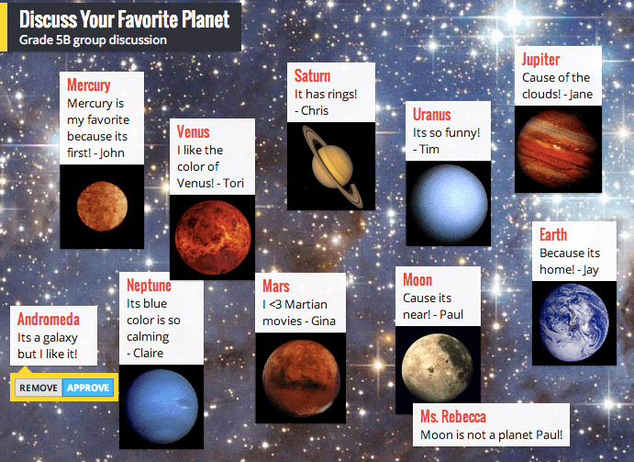
DISCUSSION
Post a picture or not and defend your answer.

Slide 13
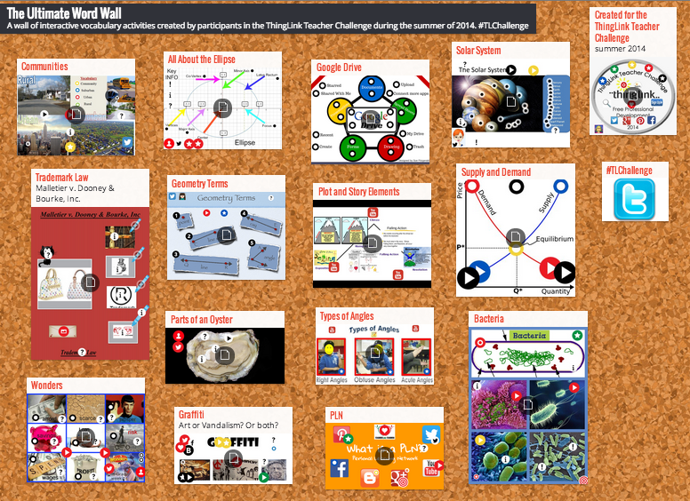
STUDENT VOCABULARY
Can be student or teacher created.
Include photos, videos, pdfs, word docs, and commentary.

Slide 14
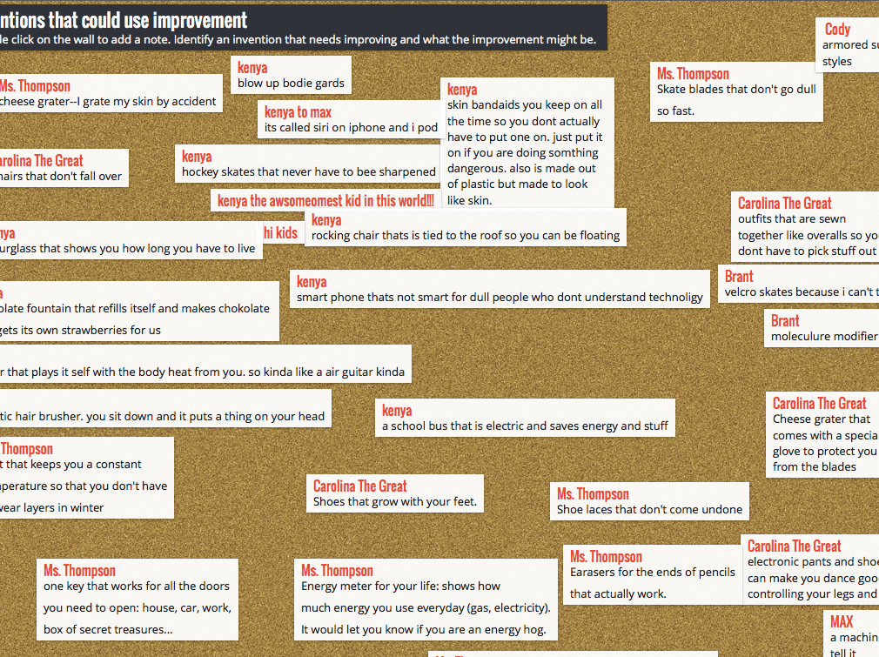
BRAINSTORMING
Ask high level questions.
Group collaboration.
Ticket out the door.

Slide 15
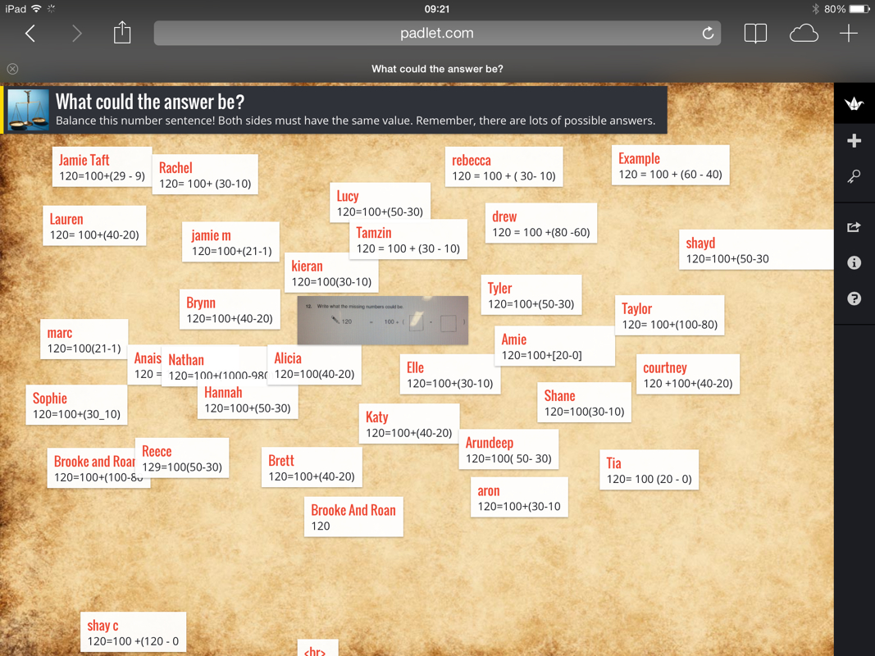
ASSESSMENT

Slide 16
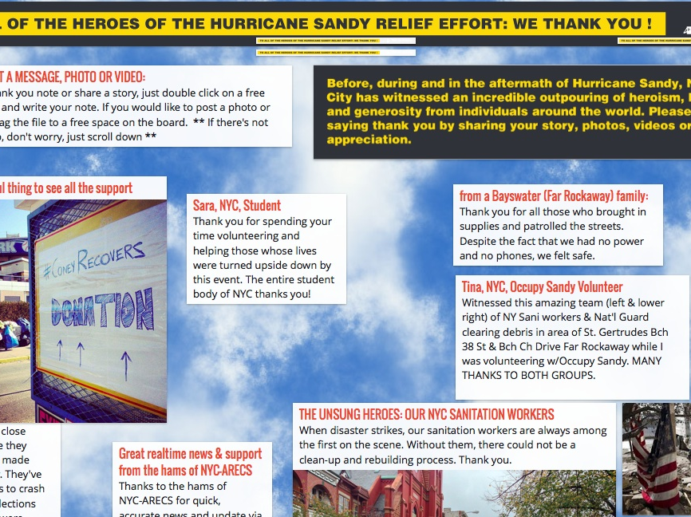
THANK YOU NOTE
REACH OUT TO OTHER CLASSES, COMMUNITY WORKERS, FAMILIES, ETC.

Slide 17
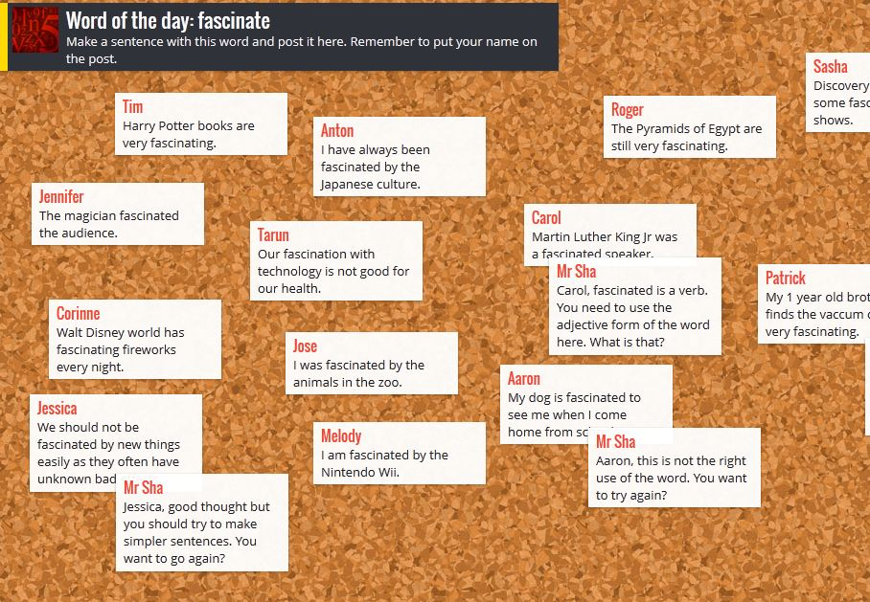
VOCABULARY
Use it in a sentence
Definitions
Prefix/Suffix
Parts of Speech

Slide 18

Add your padlet to your WEEBLY site.

Slide 19
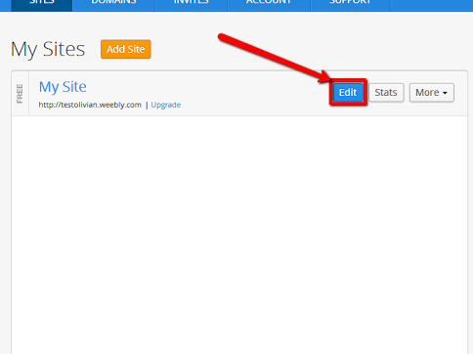
Weebly.com
Pick your site.
Click EDIT button.
Go to correct page.

Slide 20
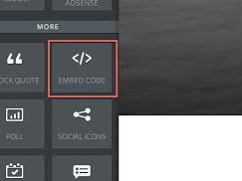
Click Embed Code.
Drag and Drop

Slide 21
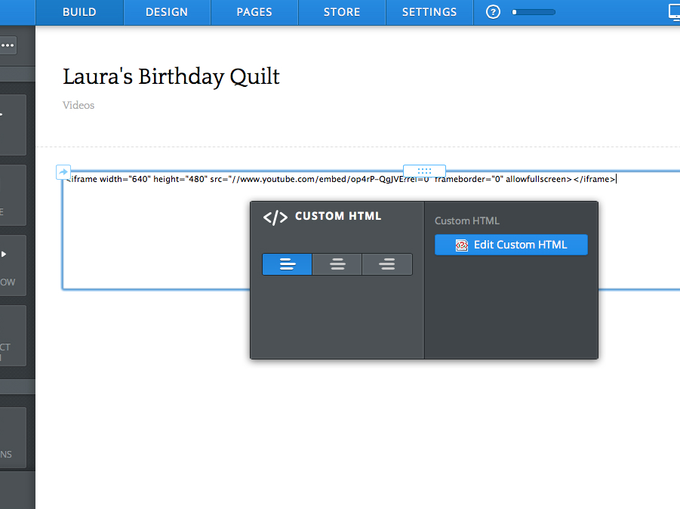
Insert HTML from Padlet.

Slide 22
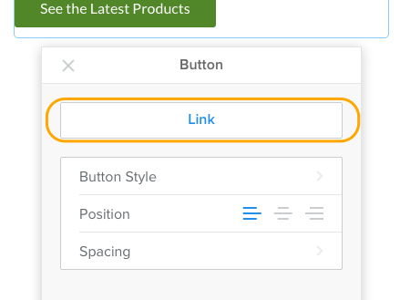
Add a Button.
Choose Button in Design Sidebar.

Slide 23
www.randolphmediacenter.weebly.com
http://padlet.com/nortonafulton/Refle
ction

