Slide 1
NOODLETOOLS
Citation Tool

Slide 2

From Desktop – choose Cobb Digital library.
Login – mabry/chargers

Slide 3
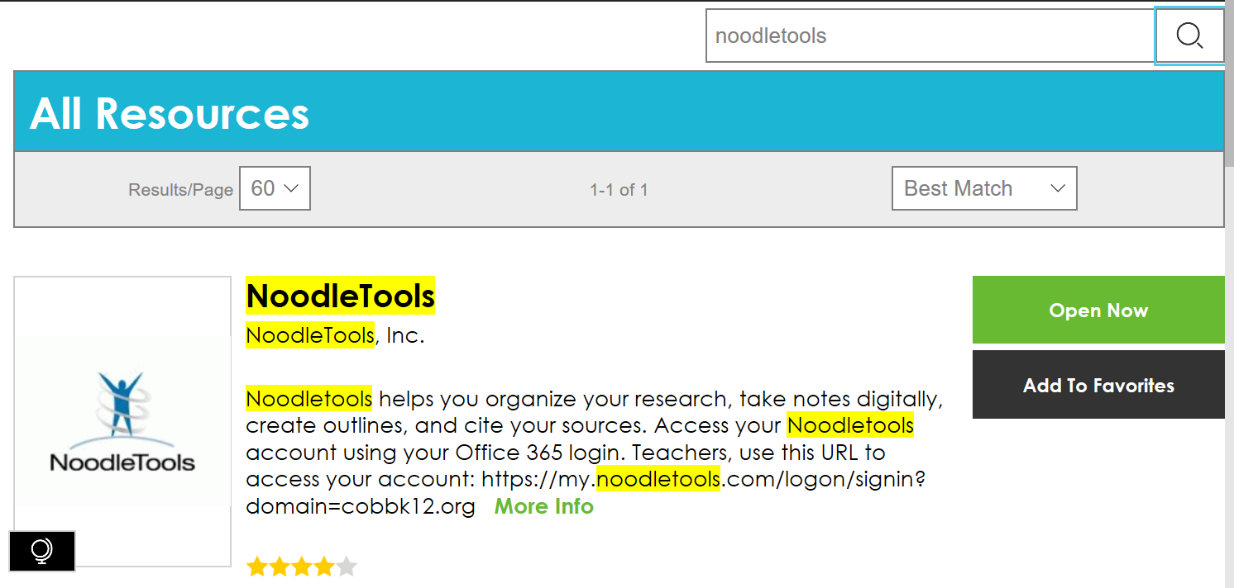
Search noodletools
Click:
OPEN NOW

Slide 4
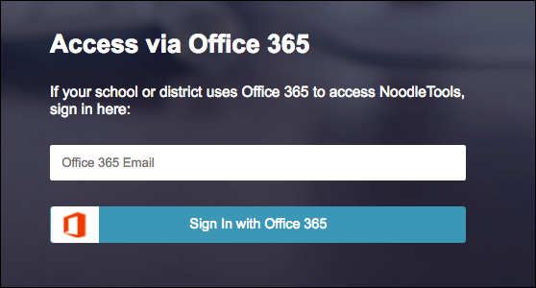
Use office 365 to access your account
If this is the first time you have logged in through Office 365, an intermediate screen gives you an opportunity to either create a new account or to link an existing account to your Office 365 account.
First.last@students.cobbk12.org

Slide 5
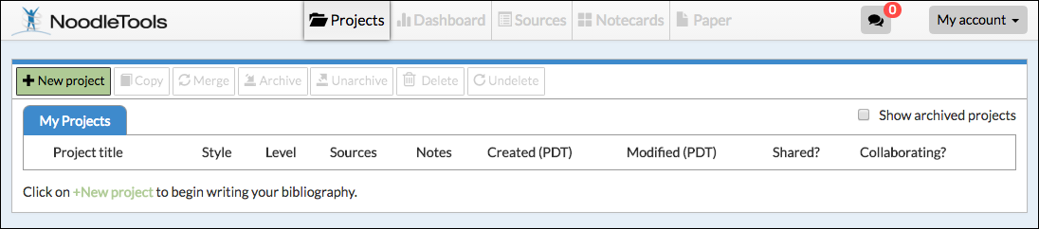
After you register, you will see the Projects screen:

Slide 6
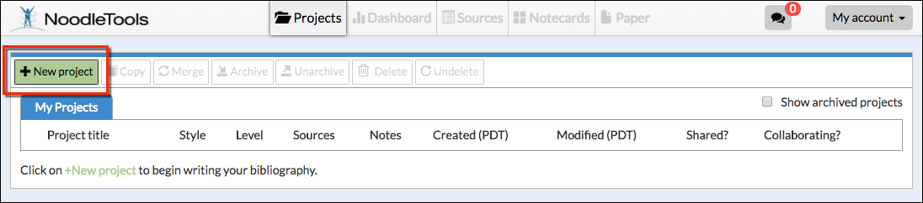
How to start a new project and a source list
On the Projects screen, click New project.

Slide 7
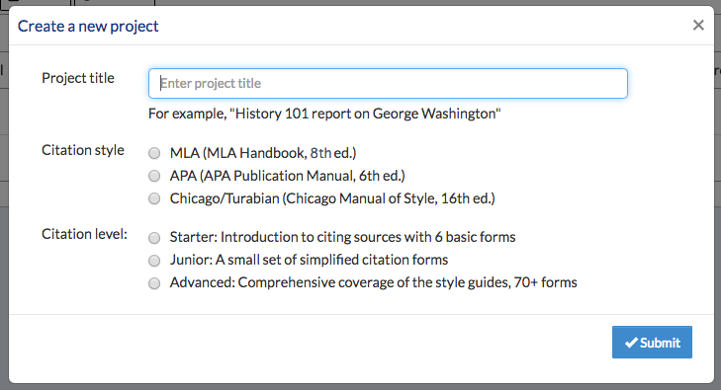
On the Create a New Project screen that pops up, enter a name for your project.
Select the MLA Citation Style.
Select Starter level.
Click Submit.

Slide 8
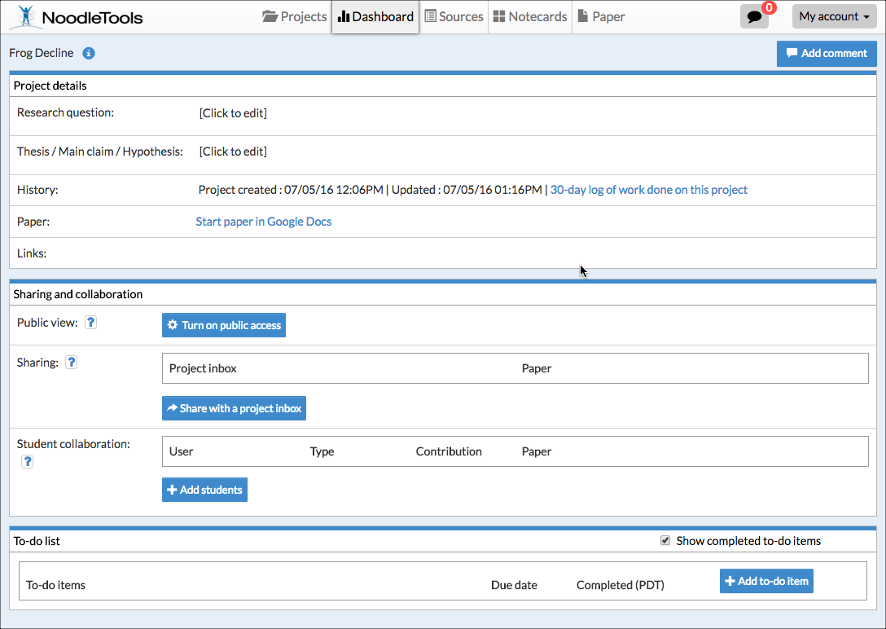
The Dashboard screen appears. The Dashboard organizes your work environment for effective research. You can see assignments, create to-do lists, submit work, and act on feedback from teachers in an organized way, and all in one place.

Slide 9
To begin citing sources,
click Sources in the navigation bar at the top.

Slide 10
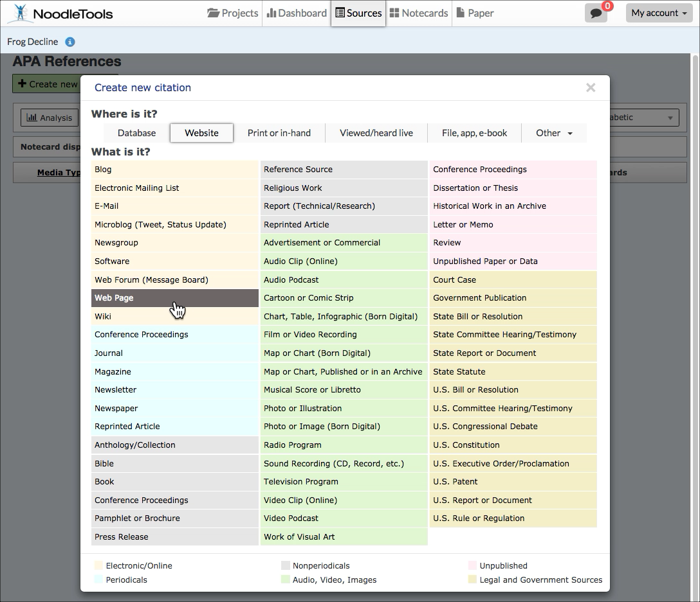
On the Sources screen, click Create new citation and select the best match for your source from the choices given.

Slide 11
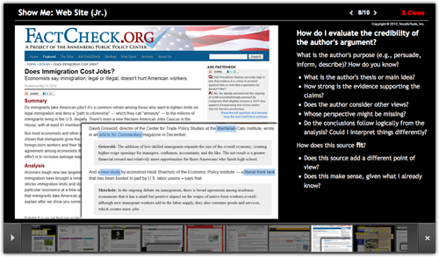
On the next screen, depending on the citation type selected, a Show Me tutorial may be available to help you evaluate the source.
Click Continue to go to the next screen.

Slide 12
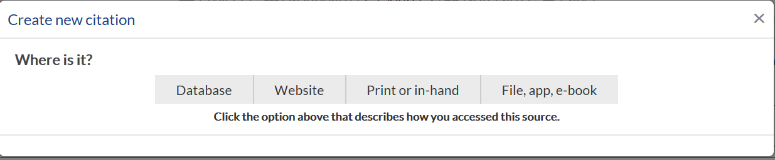
Click create new citation.
Choose type of resource.

Slide 13
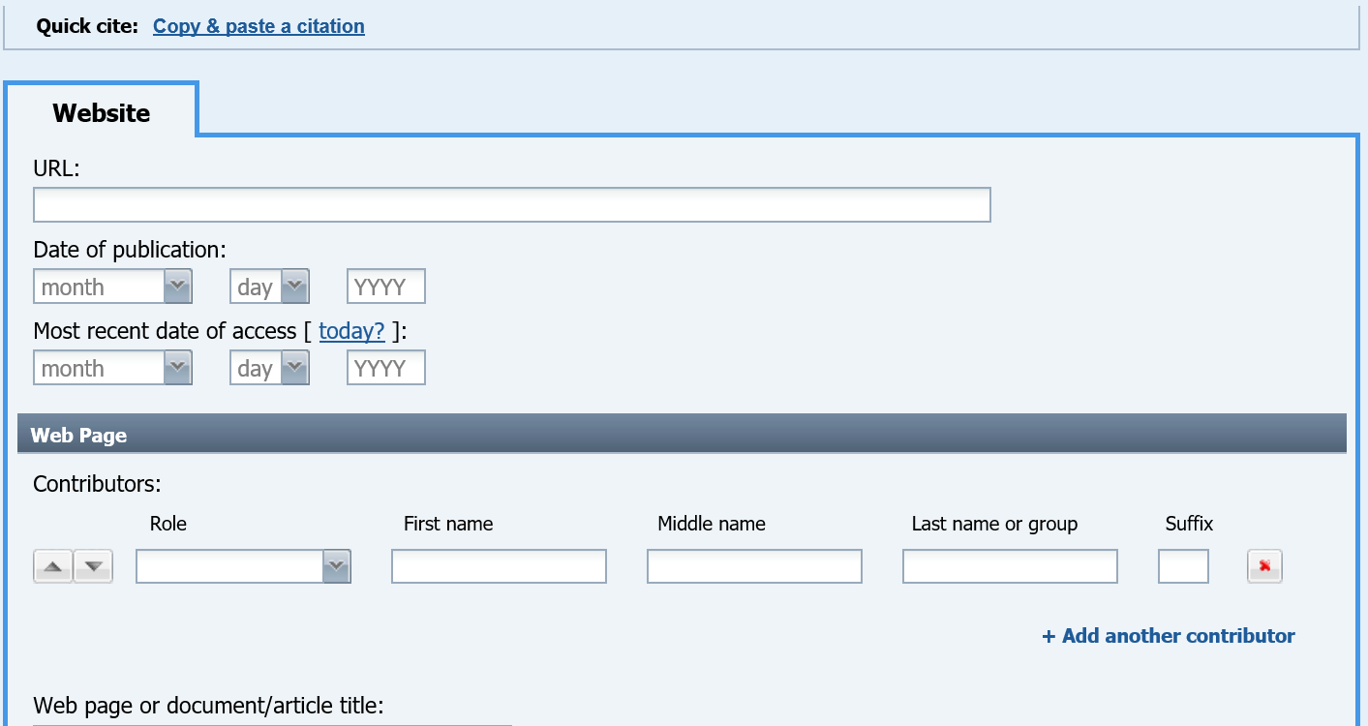

Slide 14
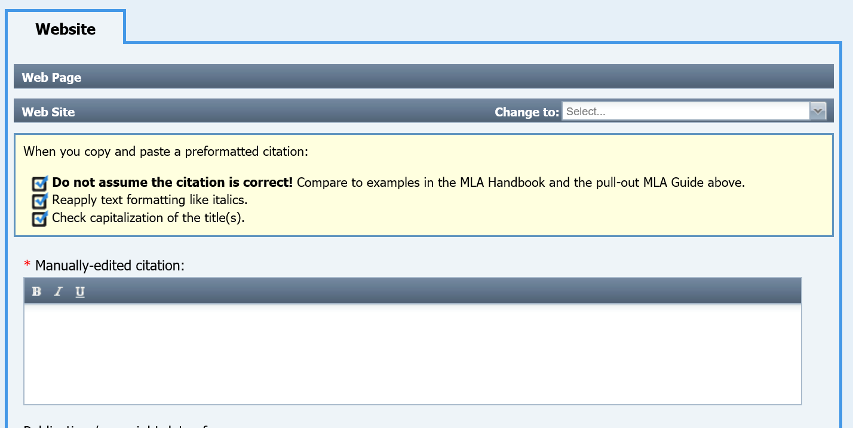
Quick cite: Copy & paste a citation Look for citation on site. Copy. CLICK “copy and paste” citation. Follow directions.

Slide 15
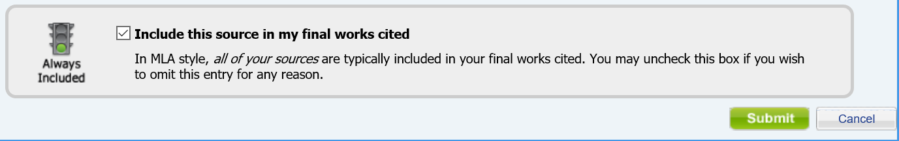
Don’t forget to submit!!

Slide 16
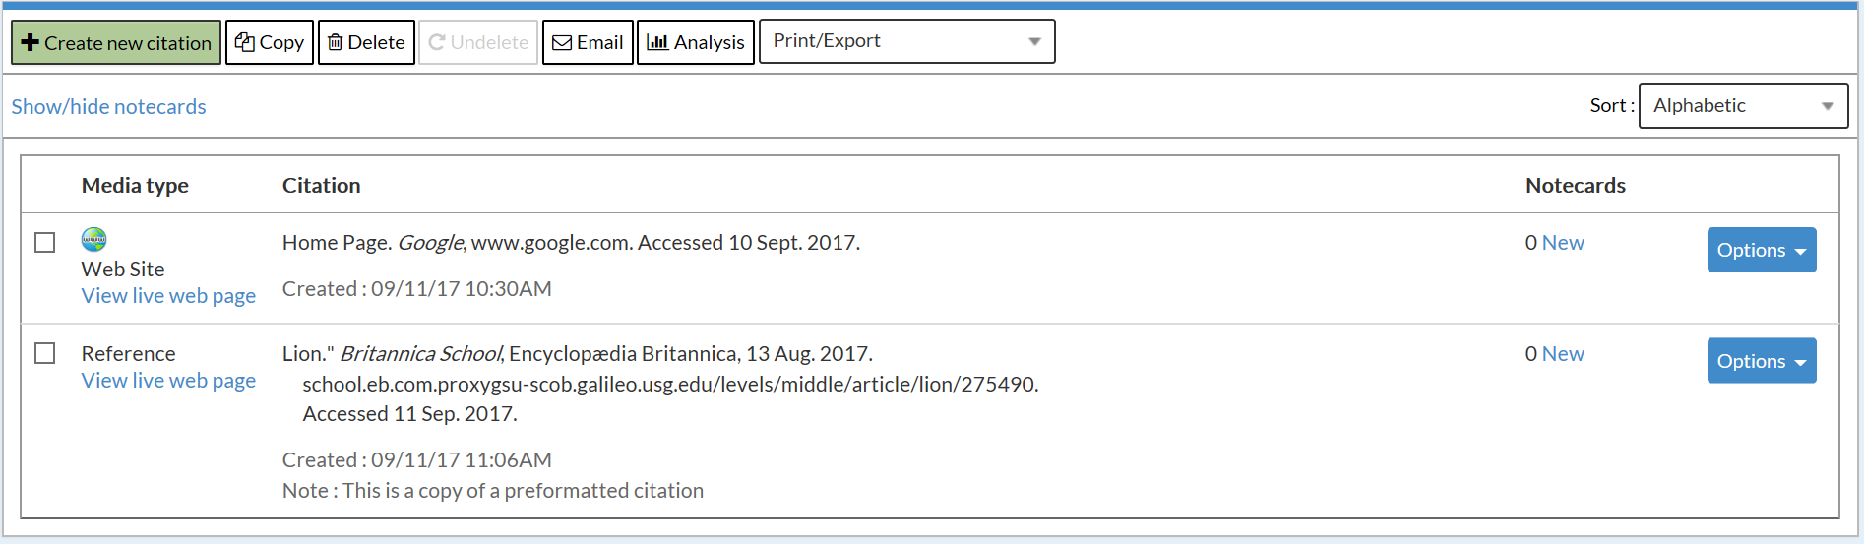
Here’s what it will look like. Make sure to sort alphabetically.
Print/export.

Slide 17
Choose Export to Word and SAVE.
Works Cited
Home Page. Google, www.google.com. Accessed 10 Sept. 2017.
Lion." Britannica School, Encyclopædia Britannica, 13 Aug. 2017. school.eb.com.proxygsu-scob.galileo.usg.edu/levels/middle/article/lion/275490. Accessed 11 Sep. 2017.

Slide 18
HAPPY NOODLING!!

